Slide 1
Fit Track
Raishimer Johan A. Salikala
Jabar S. Jayari
Amierhaisam J. Imban
Dhennur Maharan

Slide 2
Problem

Slide 3
Problem
One reason college students may not track their BMI is a lack of awareness about its importance or how to do it accurately. Additionally, busy schedules and competing priorities might lead them to overlook their health monitoring. Social pressures or misconceptions about body image could also deter some students from engaging in BMI tracking.

Slide 4
Solution

Slide 5
Solution
Using the Body Track App (Body Mass Index) app can provide a solution for college students facing various health-related challenges. Primarily, it offers a convenient means to monitor their weight and overall health status amidst the demanding college environment. By regularly tracking their BMI, students can better understand fluctuations in their weight and identify potential health risks early on.

Slide 6
PACT Framework

Slide 7
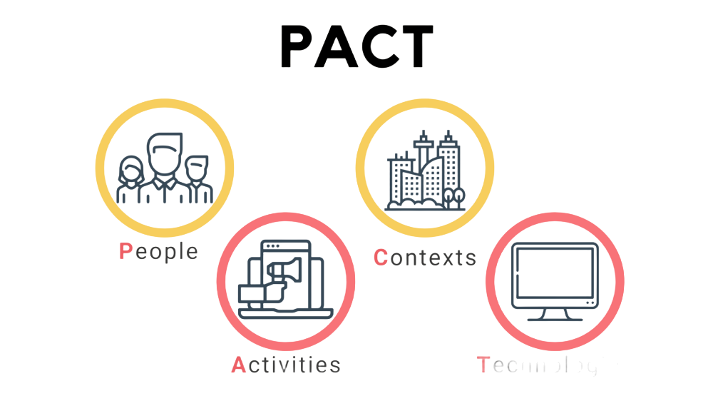
PACT Framework
PACT Analysis:
People:
College Students: Users of the BMI app seeking to monitor and improve their health and fitness levels.
Activities:
Monitoring BMI: Users regularly input their weight and height into the app to calculate and track their BMI over time.
Context:
College students often face challenges in maintaining a balanced diet and regular exercise routine due to academic and social pressures.
Technology:
Mobile App Development Platforms (e.g., iOS, Android): for creating the user interface and implementing app functionalities.
echnology

Slide 8
Figma Layout

Slide 9
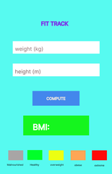
Figma Layout

